Slide 1
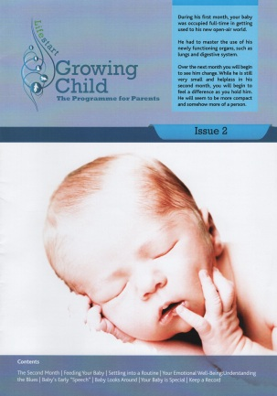
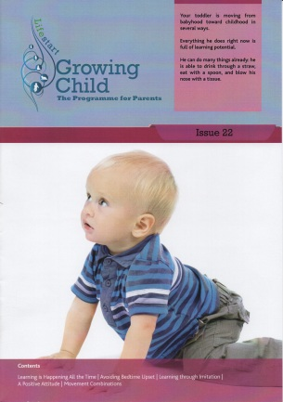
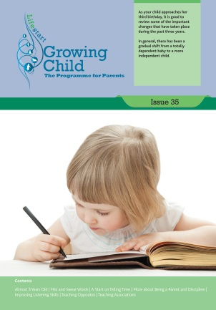
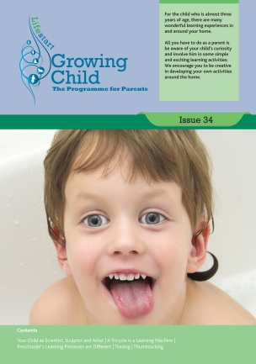
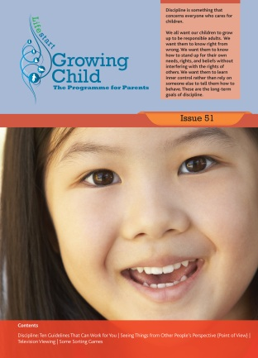
PARENTING SUPPORT INITIATIVE NETWORKING EVENT WEDNESDAY 17TH JUNE 2015
INTER-AGENCY WORKING & COLLABORATION
Mary Walker Callaghan - Lifestart Services Ltd

Slide 2
What is Inter-Agency Work?`
Often complex ad different agencies and professionals have varying views and definitions of what working together means
Horwath and Morrison (1999) suggest that what one professional identifies as co-operation another might see as collusion
No common or widely agreed definition - a ‘terminological quagmire’ (Lloyd, Stead, and Kendrick, 2001)
Buckley (2000) inter- agency and inter-professional work usually based on 3 c’s co-ordination, co-operation and collaboaration
Bardach (1998) provides a very useful definition:
“Any joint action by two or more agencies that is intended to increase public value by their working together rather than separately” (Bardach, 1998)

Slide 3
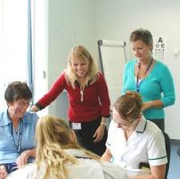
Why is Inter-Agency Work Important
No one professional has all the skills, knowledge or resources necessary to comprehensively meet all the requirements of an individual case. It is essential, therefore, that all professionals and organisations involved with a child and his or her parents/carers deliver a coordinated response’
Children First, 2011:18
Notes:
Reports, particularly in Child protection, have highlighted the lack of communication between agencies and professionals where poorer outcomes for service have occurred.
White and Featherstone (2005:213) noted that inter-agency communication would improve if ‘agency boundaries were dissolved and they all worked together in the same organisational structure.

Slide 4
Benefits of Inter-Agency Work
Ensures provision of a comprehensive response to all concerns about children
Avoids gaps in service
Early identification of any issues and intervention and prevention
Easier or quicker access to services or expertise
Better support for parents
Children, young people and family’s needs addressed more appropriately
Better quality services
Reduced need for longer-term or more specialist services.
A clear understanding of the respective roles and responsibilities of partners and
agencies
A common understanding of the professional language used across different
multi-professional disciplines
Improved achievement in education and better engagement in education
Better outcomes for children and families

Slide 5
PSI Collaborative Project Donegal (Phase 1)
The Lifestart Spirals Programme - innovative, strengths-based, group parenting programme designed around the specific needs and lifestyle context of first-time/young or vulnerable parents. The programme is constructed around the principles and themes of Aistear, the Early Childhood Curriculum Framework.
The aim of the Lifestart Spirals Programme is to empower and support parents by providing them with key information, skills and confidence that will help them to nurture their children as they grow and learn.
Collaboration between Lifestart, Donegal Children and Young People’s Services Committee, TUSLA, IFAN
Train The Trainer throughout County Donegal

Slide 6
PSI Collaborative Project Donegal (Phase 1)
72 Participants completed Lifestart Spirals Train the Trainer from
Public Health Nursing
Social Work and Social Care
Strengthening Families
Donegal Domestic Violence Service
Early Intervention Team
Early Childcare Educators
Springboard Family Support Programme
Teen Parent Support Programme
Family Resource Centres
Students from the degree programmes in Early Years Education and Social Care at LYIT
Individual Work with Families/Groups Settings
Aligned to PHN’s and consistency of information

Slide 7
PSI Collaborative Project Donegal (Phase 2)
Thematic Sessional Interventions
Topics
Preparing for Birth
Positive Mental health & Wellbeing
Routines & Sleep
Nutrition
Positive Behaviour
Speech, Language and Communication (Nursery Rhyme Book)
Toilet Learning
Play
Child Safety
Train the Trainer
Booklets for parents

Slide 8
Issues in integrated practice
Mixed Economy of Welfare
Staff operating in more complex settings/ set of relations
Implementing the Vision
Reflecting on the evidence
Evidence in practice
Commitment/Leadership
Different discourses & meaning systems
Structures of authority & legitimacy
Differences in status & power
Mediation & Brokerage
Maintaining Fidelity
Implementing new learning
Financial constraints/quality of impact
Pressures on staff
Professional & clinical supervision
Measuring the social return
Shared Goals/
Joint Activity
CYPSC
TUSLA
HSE West
Integrated approach
Boundary crossing & shared communicative processes
Innovations in Practice
More effective family support service
Opportunities for learning at practice boundaries
FRC’s
Lifestart
Parentstop
Donegal Parenting Hub
Springboard &TPSP
IFAN
Community of Practice
Parenting Education & Family Support
Better outcomes for children
Notes:
Implementing the Vision: From shared goals to joint practices
Increasing awareness of the evidence-based on practice & the use of evidence in programme/service delivery
The commitment of key people and the importance of leadership in partner organisations
Discourses/meaning systems arising from different professional and non-professional disciplines; space for misunderstandings, conflicts, privileging of different kinds of knowledge, training etc.
Differences in authority structures/definition of legitimate actions etc statutory/charitable bodies; professional/non-professional status; power of service purchaser etc.
Importance of good mediator/broker – advisory group
The importance for Lifestart to maintain programme/service fidelity in spite of potentially conflicting statutory demands/needs.
Potential problems implementing learning derived through joint practices
Funding pressures, differences in levels of remuneration and additional pressures on staff in relation to high need families
The complexity of child development outcomes, the length of time it takes for outcomes to be realised and the cost of gathering and comparing outcomes data over time raises issues for in relation to Payment by Results financing (VF PBR 2012)

Slide 9
Final Thoughts
Building “Collective Impact” – push people beyond their mission which goes beyond everyone’s work or any specific agency ‘silo’
Inter-agency work should be horizontal not vertical (Nick Frost, 2015)
Develop a better understanding of children and young people’s needs at an earlier stage
Develop good systems – taking into account the views of service users
Agreement between partners
Clear decisions – who is in or out
Clear objective and outcomes – know what you want to achieve
Make a compelling case for all stakeholders to engage
Notes:
Silo thinking – not quite as good at being integrated as we would like to think
Think beyond the model programme

Slide 10
THANK YOU
How to contact us
Lifestart Services Ltd
Main Street
Newtowncunningham
County Donegal
Republic of Ireland
Tel: +353 749156644
lifestartserviceltd@lifestartfoundation.org
www.lifestartfoundation.org

Slide 11
References
Bardach, E. (1998) Getting Agencies to Work Together: The Practice and Theory of Managerial Craftsmanship, Washington DC: Brookings Institution.
Buckley, H. (2000) ‘Inter-agency Co-operation in Irish Child Protection Work’ Journal of Child Centred
Practice, 6: 9-17.
Children First, (2011). Children First: National Guidance for the Protection and Welfare of Children. Department of Children and Youth Affairs. Dublin: Government Publications.
Frost, N at UNESCO Conference Galway 2015
Horwath, J. and Morrison, T. (1999) Collaboration, integration and change in children’s services: Critical issues and key ingredients. Child Abuse & Neglect 31 (2007) 55–69
Lloyd, G., Stead, J., and Kendrick, A. (2001) Hanging on in there. A study of inter-agency work to prevent school exclusion in three local authorities. London: NCB. (P 3).

