Slide 1
Overview of Parenting Support Initiative
Noelle Spring, Foundation Director
Katharine Howard Foundation
17 June 2015

Slide 2
16 Core Projects
Downstrands Family Resource Centre
The Chatterbox Service

Slide 3
Welcome
To the Core Projects
Advisory Group Members
KHF & CFI

Slide 4
The Background to PSI
The Parenting Support Initiative (PSI) is a collaborative partnership between the Katharine Howard Foundation (KHF) and the Community Foundation for Ireland (CFI).
The Initiative is a three year (2013-2016), strategic grants programme with a focus on children from birth to 3 years and their parents, with a particular emphasis on supporting parents in their parenting role. Some projects in the initiative also support parents at the ante-natal stage.
A joint fund totalling €600,000 has been allocated for this initiative over the three year period.
The PSI was launched in September 2013 and over 200 applications were received. This response indicated a high level of the interest from a diverse range of organisations within the community, voluntary and statutory sectors. Out of the 200 applications, 16 core projects were awarded funding of €180,000 in 2014 (nationwide). Due to the high level of response and quality of applications a further €100,000 was allocated by KHF to 43 projects as once-off small grants in 2014.
The 16 core projects are already entering year two of implementation and delivery and a total amount of €186,500 has been approved for the second year of the initiative with a potential for further funding in year 3 (progress dependent).

Slide 5
The Objectives of the PSI Include:
Strengthening prevention & early intervention supports for young children and families to achieve better health, well-being, and learning outcomes
Reinforcing the developmental role of both community and national based services working directly with children from birth to 3 years and their parents (CYPSCS; Resource Centres & other community based services)
Strengthening the links between existing health and community based services to support a holistic approach to meeting the needs of infants and young children
Building and sharing the learning from initiatives such as the Prevention & Early Intervention Initiative (PEIP), and the National Early Years Access Initiative (NEYAI)

Slide 6
PSI – Implementation Process
1. Planning (Exploration) Stage : (2012-2013)
KHF learning through review and strategic planning process
Experience and understanding of importance of evidence based/evidence informed approach
Gaps identified through consultation and reflection process
Highlighted importance of prevention and early intervention- improving outcomes for children- importance of role of parents

Slide 7
2. Development Of PSI (Installation Stage) 2013
PSI – Implementation Process
Collaborative approach between KHF and CFI- 3 year programme
Clarified Programme focus - children birth-3 years and their parents with a particular emphasis on supporting parents
PSI aims and objectives developed
Advisory Group established to support the development and Implementation of PSI

Slide 8
PSI – Implementation Process
3. Implementation Stage: Year 1 (2013-2014)
Grants Process planned including application process, grant guidelines and selection criteria
PSI launched September 2013
Funding allocated €280,000:
16 Core Project Grants
43 once off Small Grants for 2014
Project Implementation plans completed, including timeframes and Project evaluation plans

Slide 9
Implementation Stage 2014
KHF review of work plans
Identifying common issues/themes
Agreeing PSI Evaluation Framework
Networking Event – April 2014
Mid–Year Review and Information Newsletter
Project End of Year Review and Guidelines and Criteria for Year 2 funding
Project Progress Reports

Slide 10
PSI – Implementation Process
4. Implementation Stage: Year 2 (2015)
Review of Project End of Year Reports
16 Core Projects Funded 2015 - €186,500
Communication Plan developed for PSI projects and wider audiences
Project Support Plan
Sharing the Learning Networking Event
Projects Evaluation

Slide 11
Overview of Project Plans for Year (2)
Overall the focus of the 16 Core Projects remains unchanged
Projects continuing with the same focus and direction building on the learning and work for Year 2, with new activities to enhance same
Some projects have made slight changes to project plans including expanding to new locations or targeting a more specific cohort of parents but overall the focus of the projects remain unchanged

Slide 12
Core Projects & Programmes Delivered
1. Ballinasloe Social Services, Galway | Delivery of Incredible Years Parenting Programmes and the Hanen programme.
2. Barnardos, Dublin | Delivery of ‘Flying Start’ programme and Parents Plus
3. Bedford Row, Limerick | Parenting support programme for women prisoners and ex-prisoners
4. Bessborough Centre, Cork | Parent Infant Health Practitioner-to lead Baby Together Group
5. Canal Communities Partnership, Dublin | Parent Child Home Programme (PCHP)
6. Chatterbox, Cavan & Monaghan | ELKLAN Speech and Language Project
7. Cork City Partnership | Training Early Years Practitioners in Incredible Years Parent and Baby Programme and delivery to parents
8. Downstrands FRC, Donegal | Delivery of Child and Parent Programmes to Family Resource Centre (FRCs) Donegal
9.Kerry Children Services Committee (KCSC) Kerry | Delivery of Language and Play Programmes to FRCs and Parent and Toddler Groups
10. Lifestart, Donegal | Train the Trainers ‘Spirals’ Parenting Programme for practitioners
11. Longford Community Resource Ltd | Filial Play Therapy
12. Monaghan Integrated Development Ltd | Training Community Childcare Staff to deliver Early Years Parents Plus Programme across the county
13. National Association of Building Co-operatives Society Ltd (NABCO) Dublin | Delivery of parenting support programmes- including Parents Plus Programme
14. Pavee Point Traveller & Roma Centre, Dublin 1 | Parent Child Home Programme (PCHP) – Delivery of programme to traveller families in Blanchardstown and Finglas areas
15. Southside Partnership, Dun Laoghaire, Co. Dublin | Delivery of an Integrated Early Intervention and Family Support Initiative
16. Tolka Area Partnership, Dublin | Delivery of Parenting ante-natal and post-natal support programme. To include Incredible Years in Year 2

Slide 13
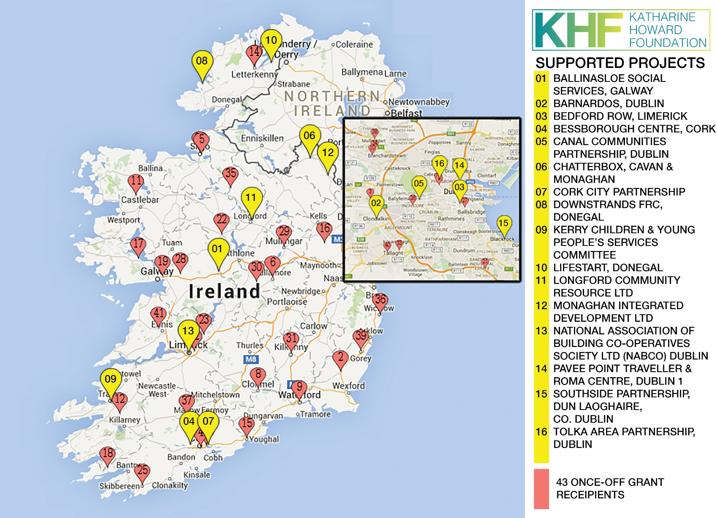

Slide 14
Project Presentations
‘Identifying Ways of Engaging Parents’
‘Inter-agency Collaboration’
‘Implementation of PSI Projects – Successes/Achievements/Challenges’

