Slide 1
The Nurture Programme - Infant Health and Wellbeing

Slide 3
The Nurture Programme - Infant Health and Wellbeing will build on the best practice already in our services

Slide 4
We commit to ensuring that parents are at the heart of our work
Parents will be involved in the development of the Programme and all its resources

Slide 5
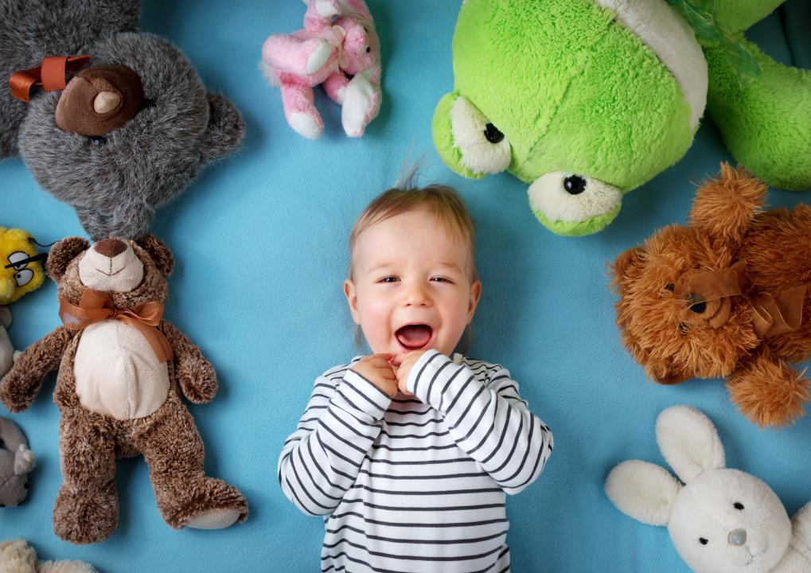
Quote from a Mum
‘....the public health nurse was incredibly supportive... she came out four days in a row ’

Slide 6
Quote from a Dad
‘....the antenatal course was very helpful because you don’t know what to expect on your first pregnancy so it normalises it a bit...it is the only real information I received as a father on labour...’

Slide 7
Quotes from a Mum
‘The nurse called. I found out about the breastfeeding group. It was within walking distance... it was brillant...’

Slide 8
Quotes from a Mum
‘Without the midwife I would have been lost... they are amazing...they keep you calm and reassure you...’

Slide 9
Quotes from a Mum
‘ Every time I walked out of an appointment ...there’s a lot of new information....if he’s crying and upset I’m a bit upset as well, you’re tired, you’re not taking in information...’

Slide 10
Quotes from a Mum
‘ The immunisation system seems to be very well organised. I would receive a reminder around these visits...’

Slide 11
Quotes from a Mum
‘ I got very good medical care in the maternity hospital but less good on emotional care and support’

Slide 12
Quote from a Mum
‘Without the midwife I would have been lost... they are amazing...they keep you calm and reassure you...’

Slide 13
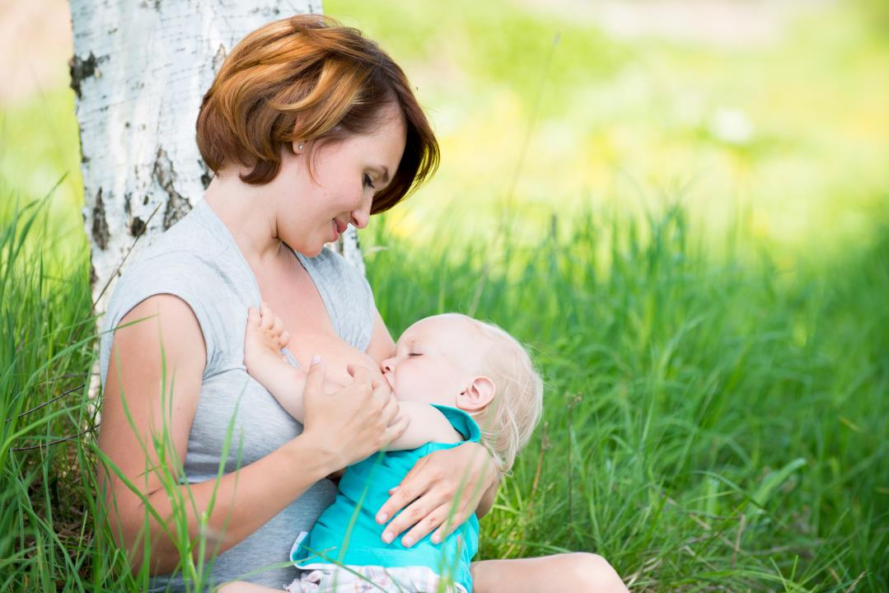
Quote from a Mum
‘ My home visitor told me that my breast milk was liquid gold....that stuck in my mind and I breastfed my fourth baby because of this...’

