Slide 1
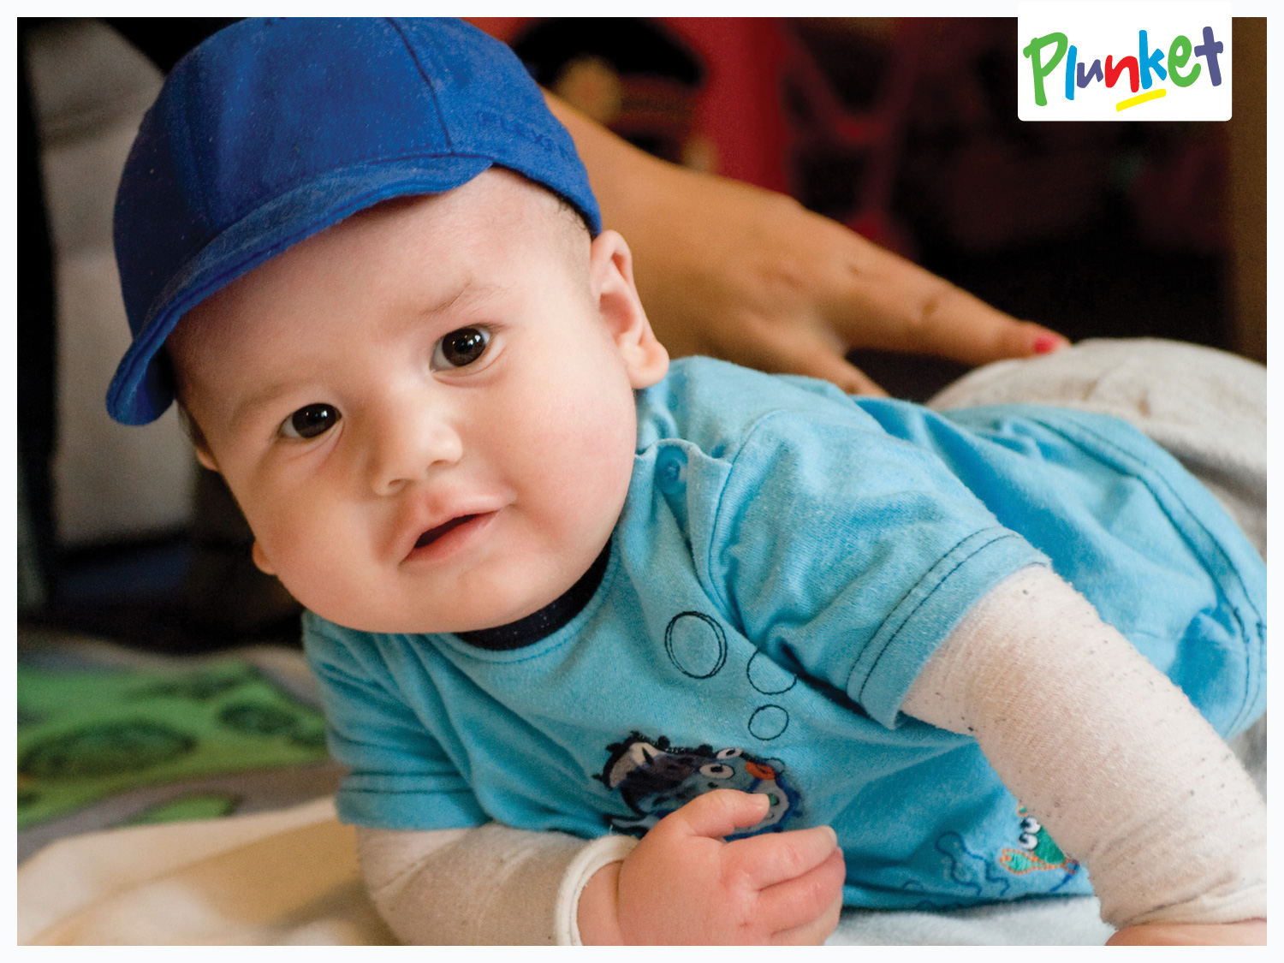
Well Child Tamariki Ora Nursing in the New Zealand Context
Karen Thurston BN, MN (Clinical)

Slide 2


Tēnā koutou katoa
Greetings, to you all
Notes:
Ko Taupiri te māunga
Ko Waikato te awa
Ko Grant tōku tīpuna
Ko Heather Toku Mama
Ko Mike Toku Papa
Nō Tamaki Makato ahau
Ko Paul Thurston Taku Tane
Ko Jordan and Chase Take Tamariki
Ko Karen Thurston tōku ingoa
Welcome, my introduction is a pepeha and within Maori Culture is essential when introducing yourself as it identifies where you are from and your place in time. This is particularly important as Whakapapa or Genealogy is seen as essential to moving forward and being true to your culture, beliefs and customs. It also helps to instil a sense of pride and mana. As a Pakeha women I embrace Maori culture as it is unique to my country and is part of my story and that of my children.
Basically I introduced:

Slide 3
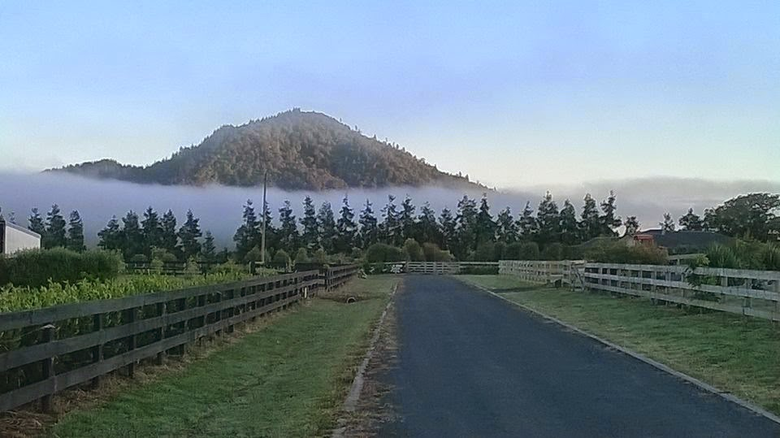
Notes:
My Mountain Taupiri

Slide 4
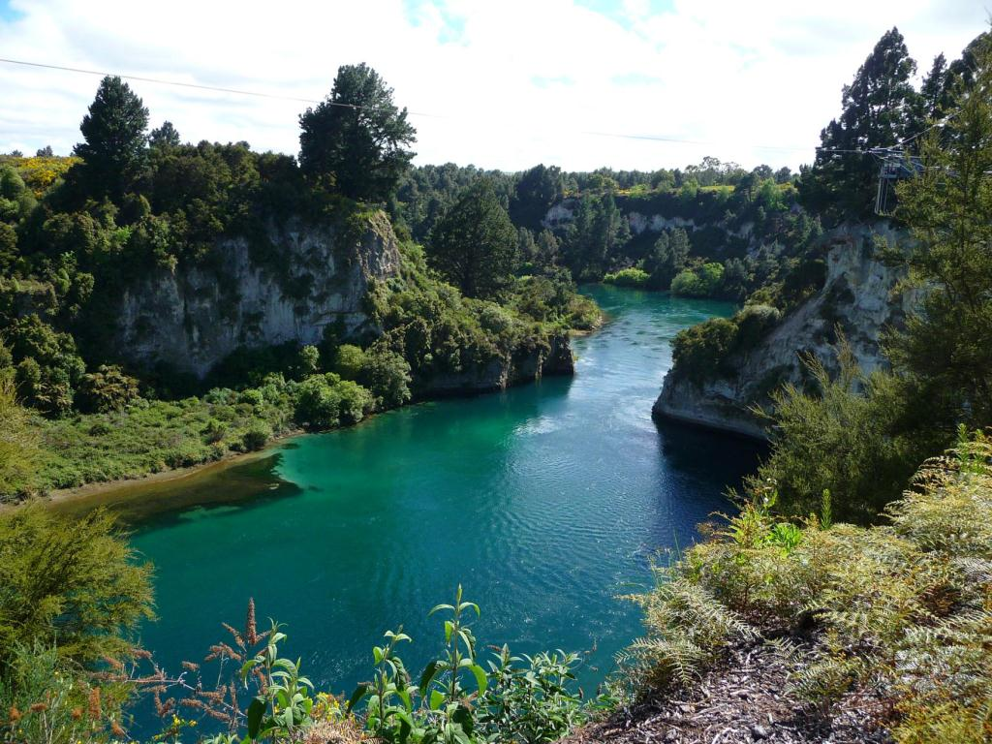
Notes:
My River the Mighty Waikato

Slide 5

Notes:
I identified that my Madan name is Grant therefore this is one of the clans I belong too.

Slide 6

Notes:
I was born in Auckland to Heather and Mike

Slide 7
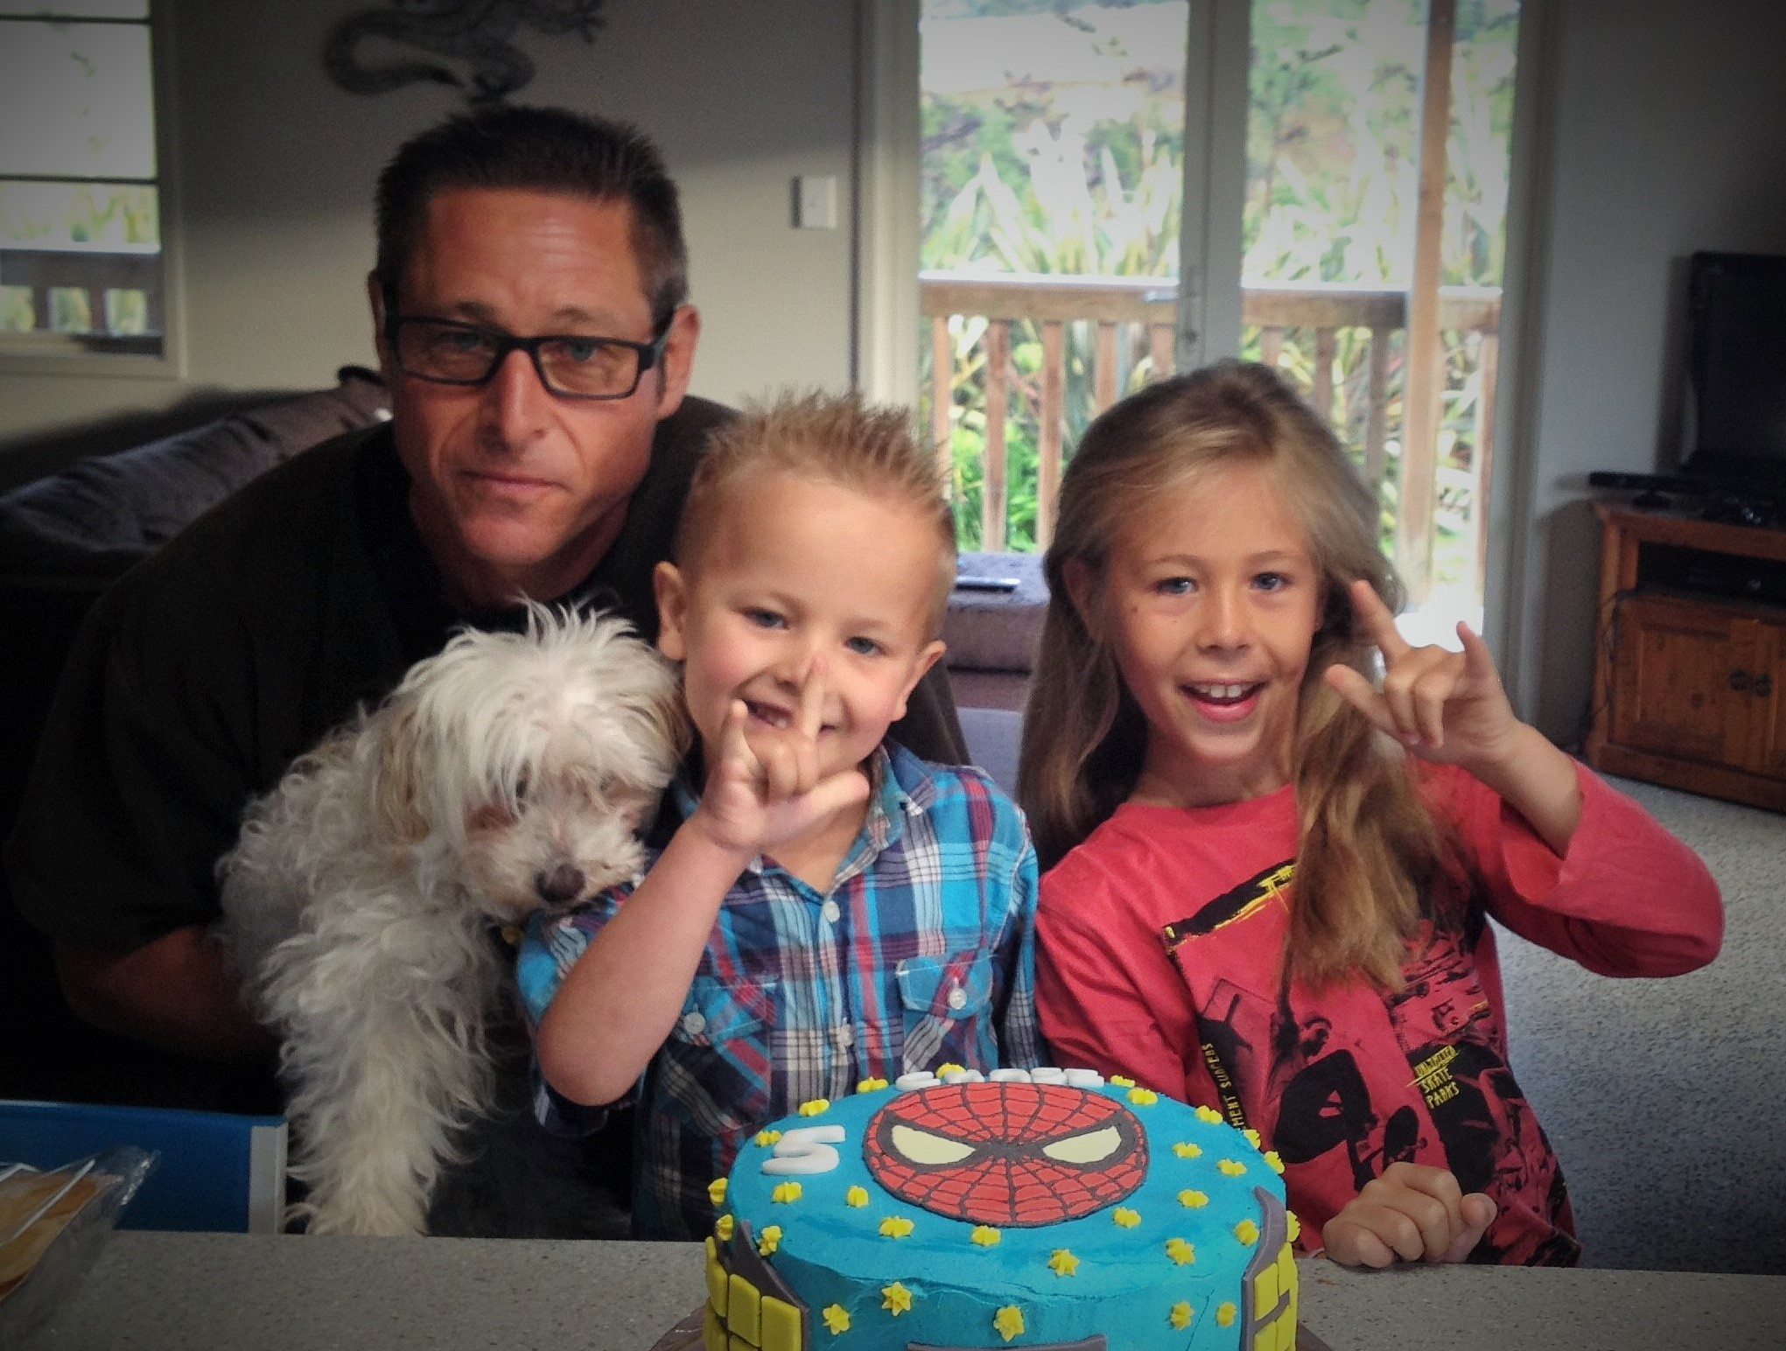
Notes:
And my husband Paul, daughter Jordan, and son Chase. And I am Karen Thurston. Amongst other things I have been a Well Child Tamariki Ora Nurse since graduating with a bachelor of Nursing in 2007. I have the privilege of supporting the families of Ngaruawahia, which is a small township of 5000 people just north of Hamilton in the North Island of New Zealand. Ngaruawahia is considered a high needs high deprivation community, with a higher than the national average unemployment rate. It also has more single parent households. Families living in this area are also more likely to have less disposable income, and are less likely to own their own home. Ngaruawahia’s Maori ethnicity identification rate is 60% compared to the national average of 19. This factor alone increases the likely hood of acute and chronic conditions as Maori have higher rates of morbidity and mortality related to contemporary health issues than any other ethnicity group within New Zealand. This is predominantly linked back to early colonisation and the impact of assimilation on their traditional ways of being. In the field of Well Child Tamariki Ora nursing we typically see higher rates of serious skin infections, acute and chronic respiratory complications and the resurgent's of third world conditions such as rheumatic heart disease and dental caries requiring general anaesthetic. Maori babies are also more likely to die from SUDI than their non-Maori counterparts. Ultimately, reducing these trends is at the forefront of New Zealand’s health policy makers minds. As a nation we are strategically trying to combat these disparity to achieve health for all. Likewise, Ngaruawahia as a community has great pride, mana and history that strengthens its overall capacity. It is home to the meeting house of the Maori King at Turangawaewae and is surrounded by the majestic mountains of the Hakarimata Rangers.

Slide 8



Margaret May Blackwell
Travel Study Fellowship
Notes:
I have to thank Francis Chance and his colleagues at the Katherine Howard foundation for organising this presentation. I am really excited to have the opportunity to come and speak to you today about my experience of working as a Well Child Tamariki Ora nurse in New Zealand. This has been made possible since applying for and being awarded the Margaret May Blackwell Travel Study Fellowship. Margaret Blackwell was one of our original Karitane Nurses who trained in Dunedin New Zealand. She was a fierce advocate for child health and child rights and is best known for escorting children during the second world war from England to Canada to ensure their safety. Her fellowship gives nurses an opportunity to explore areas of practice aimed at improving health outcomes for children under five. This Fellowship is over seen by the NZNO and NZ Nursing education and research foundation. As a general outline the purpose of my travel is to develop nurse prescribing roles within our current Well Child Tamariki Ora Framework. Todays presentation will hopefully give you an insight into the past present and future of Well Child Tamariki Ora Nursing in New Zealand, and some of the health outcomes we are achieving particularly within our high needs and Indigenous populations.

Slide 9
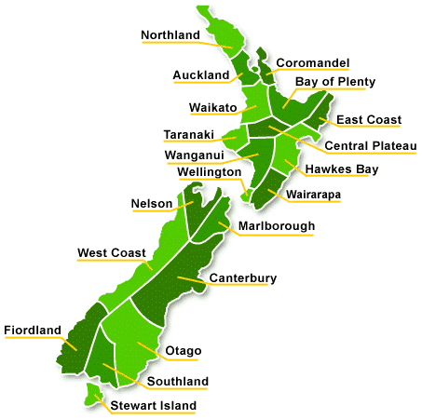
New Zealand’s Health System
Publically Funded Health System
Ministry of Health (MOH)
20 District Health Boards (DHB)
Primary and Secondary Providers
Notes:
So in New Zealand we are a publically funded health system. Our Ministry of Health directly funds 20 regional District Health Boards who then decided what services their individual populations need.

Slide 10

Byline or author if required
Notes:
Some of these services are standardised across the country such as the recent implementation of zero fees for children under the age of 13 for Gp visits and prescriptions.

Slide 11
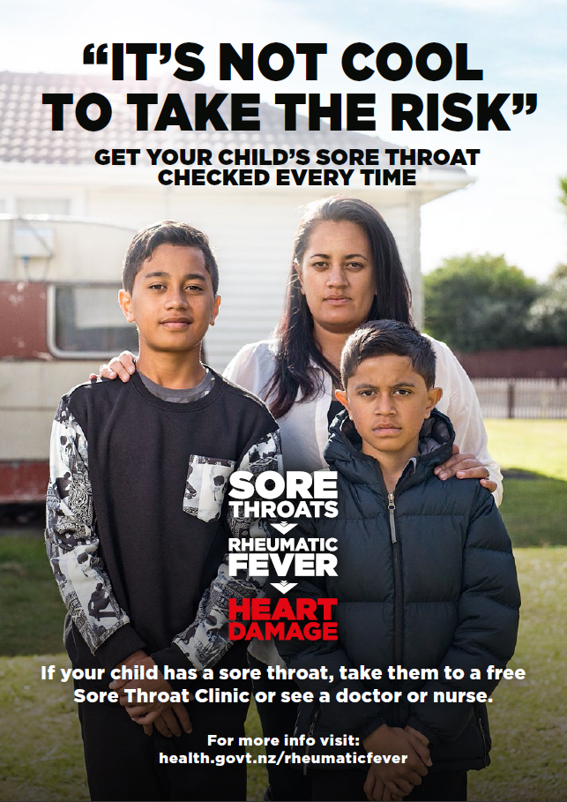
Byline or author if required
Notes:
Whereas some are targeted too certain populations and regions. Such as our sore throat management program that aims to reduce the high rate of Rheumatic Fever predominantly experienced amongst our Maori and Pacific children living in the far north

Slide 12
Providers Of New Zealand’s
Well Child Tamariki Ora Program
WCTO
GP
LMC
Notes:
One such Initiative that incorporates both a universal and a targeted approach to health care is our publically funded Well Child Tamariki Ora Program. This program is delivered by three groups of health professionals. They are Lead Maternity Careers, General Practitioners and Well Child Tamariki Ora Nurses. In New Zealand Well Child Tamariki Ora Nursing is a specialised role. Registered Nurses wanting to become a Well Child Tamariki Ora Nurse must complete a post graduate certificate in Primary Health Care Specialty Nursing. This is supported by on the job training that increases their knowledge around maternal, infant, child and family health. The importance of this role being specialised is supported by our ongoing appreciation on how a child’s first 1000 days significantly impacts their future health and wellbeing. In New Zealand we have recognised the importance of supporting caregivers to develop strong positive attachments with their infant in-order to maximise their potential. We are also starting to really appreciate the increasingly crucial role fathers have to play in developing these strong secure children, along with the emotional impact being a father has in todays complex society. Therefore, father inclusive practice is now a term used widely across our organisation as a means to lift the profile of this significant role.

Slide 13
12 Universal Core Contacts
Visit Time Frame | Provider
Birth to 24hrs Check | Lead Maternity Carer
Up to 1 week Check | Lead Maternity Carer
Transition Care Check | Lead Maternity Carer
4-6 Week Check | Well Child Tamariki Ora
6 Week Check | General Practice Team
8-10 Week Check | Well Child Tamariki Ora
3-4 Month Check | Well Child Tamariki Ora
5-6 Month Check | Well Child Tamariki Ora
9-12 Month Check | Well Child Tamariki Ora
15-18 Month Check | Well Child Tamariki Ora
2-3 Year Check | Well Child Tamariki Ora
4 Year Check | General Practice Team
Notes:
Currently, there are 12 Universal Core Contacts that every child is entitled to under the age of 5. The first is initiated at birth by the child’s Lead Maternity Carer. He or she has generally been with the family from confirmation of pregnancy till around 6 weeks postpartum. This is because in New Zealand we have a midwife-led model of care. Well Child Tamariki Ora Nurse’s then become involved at 2-4 weeks postpartum and compete 7 full universal assessments with the final being the 2-3 year check. The child’s General Practice team is also a key provider of our Well Child Tamariki Ora service. They complete the 6 week assessment and the Before School Check that is aligned with the child's 4 year immunisations.

Slide 14
Three Parallel Streams of the
Well Child Tamariki Ora System
Health and Development | Care and Support of the Family/Whanau | Health Education
Taking of a comprehensive Family Health History | General Family Health and Wellbeing | Breastfeeding
Comprehensive Physical Assessment | PND Screening | SUDI Prevention
Comprehensive Development Assessments | Family Violence Screening | Recognition of Childhood Illness
 | ABC Smoking Cessation | Safety and Injury Prevention
 |  | Child Development and Positive Parenting Strategies
 |  | Oral Health
 |  | Early Child Hood Education
Notes:
Each of the 12 Universal Core Contacts are underpinned by three equally important themes. These are Health and Development, Care and Support of Family/Whanau and Health Education. When working with families we recognise the impact socio-ecological factors have on positively or negatively effecting health and wellbeing. Therefore as part of our Well Child Tamariki Ora training we develop a community profile that outlines the local health and social services available. This enables us to support families to access the services they need to improve their ongoing health and wellbeing. Ongoing networking is also strongly encouraged within the organisation that I work. This involves liaising with local parenting support groups, social workers, Early Childhood Educators and other medical service providers. With the passing of the Vulnerable Children’s Act 2014 we have also been able to develop closer relationships with our child protection agency Tamariki Oranga, who reside under the direction of the Ministry of Social Development. This act has broken down some of the barriers to information sharing regarding at risk families in an attempt to reduce our high rate of child abuse and neglect that is often linked to family violence.

Slide 15
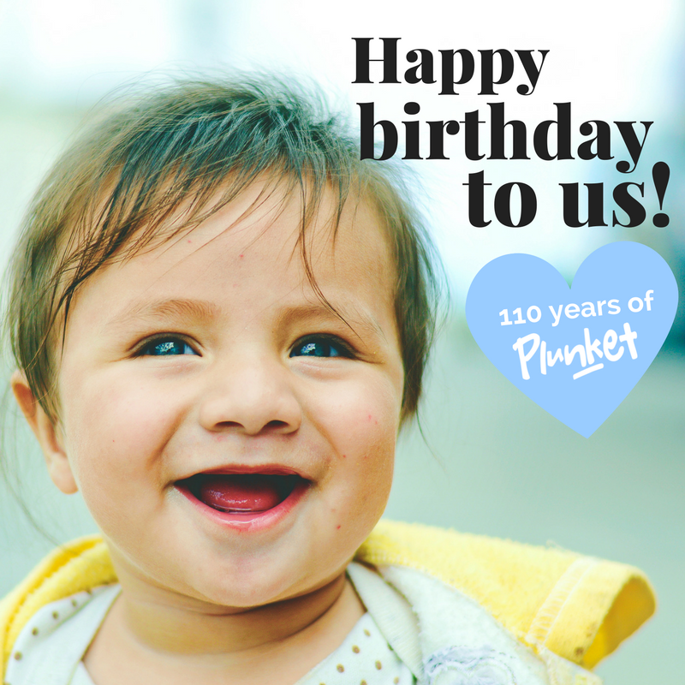
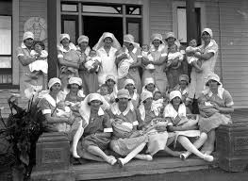
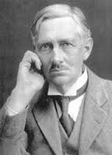
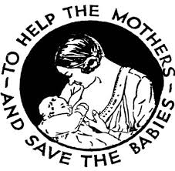
The History of Plunket
Notes:
As a Well Child Tamariki Ora Nurse I work for the Royal New Zealand Plunket Society. Plunket as it is generally referred too is our countries leading provider of our Well Child Tamariki Ora nursing. We have the privilege of engaging with over 90% of all babies born in New Zealand. Plunket as a provider of healthcare is unique in the fact that it is a Non-Government Organisation that negotiates directly with the Ministry of Health rather than through the District Health Boards to provide the universal and targeted services we offer. This year our society turns 110 years old and our historical theme of “To help the mothers and save the babies” lives on in the hearts and minds of the staff that provide support today. Originally, Plunket was founded on the revolutionary thinking of Sir Frederic Truby King, who identified that babies living in Dunedin were dying from malnutrition and disease. He opened the first Karitane hospital for mothers and babies in 1907, and with the support of Victoria Alexander Plunket whose husband was the governor general of New Zealand at the time the Plunket society was born. However, a lot has changed since then. The traditional Karitane hospitals no longer exist, and Well Child Tamariki Ora nurses can be seen delivering care in homes or at local clinics across the country. We still have our volunteer arm who provide local initiatives such as parenting education and playgroups through fundraising efforts and grants. However, the majority of our clinical services are funded through the state. We have also progressed from a somewhat authoritarian model of care to one that is based on working in partnership with families.

Slide 16
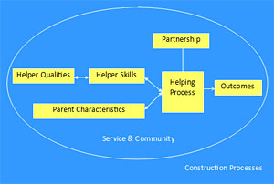
Family Partnership Model
Promotes the Development of Effective Communication Skills
Promotes Client-led Health
Outcomes and the
Establishment of
Authentic Relationships
Promotes the
Development of Reflective
Practice and Cultural
Safety
Byline or author if required
Davies & Day. (2010)
Notes:
The shift away from an authoritarian model too one that is based on partnership has been facilitated by our current Well Child Tamariki Ora nurse training. Not only do we complete a postgraduate diploma in Primary Health Care Specialty Nursing, but we also participate in family partnership education that is based on Davies and Days Family Partnership model. This training provides us with the tools to acknowledge our own constructs and that of the families we visit in-order to prevent misunderstanding, unintentional judgement and alienation. Instead practitioners develop communication skills that:
Promotes thoughtful enquiry
The development of objectives that the client sees as beneficial
And the promotion of reflective practice that is cultural safety
Reflective practice is also facilitated by the incorporation of regular peer reciprocal supervision. Once every six weeks we get together with an assigned colleague to discuss areas of practice that we are concerned about, or complete a case review in order to identify areas for improvement.

Slide 17

Physical Well Being
Figure 1: Te Whare Tapa Whā
Extended Family Well Being
Spiritual Well Being
Emotional
Well Being
Notes:
Ultimately, cultural safety and reflective practice throughout the New Zealand nursing context is seen as crucial when working in partnership with families. This is because it acknowledges the expertise both the nurse and the client bring to the nurse-client relationship. Likewise, upholding the intentions of our countries Treaty of Waitangi is woven throughout our nursing training and is reflected in our national nursing competencies. The Treaty of Waitangi is one of New Zealand’s founding documents that despite its controversy binds Maori and Pakeha together as active caretakers of the land and people. The treaty identifies three main principles. These are Participation, Partnership and Protection. In particular, when working with Maori clients I am mindful of the importance of incorporating these principles into my care delivery approach. One Maori model of health that guides this approach is Te Whare Tapa Wha. This model outlines the elements that Maori believe are essential to health and wellbeing. It is represented as a Whare or house and demonstrates how weaknesses in any of the four walls can compromise health. These elements are:
Taha Tinana Physical Wellbeing
Taha Wairua Spiritual Wellbeing
Taha Whanau Extended Family Wellbeing
Taha Hinengaro Emotional Wellbeing
This approach to nursing is not unique to my practice, but is encouraged across the Plunket workforce as outlined in our standards of practice.

Slide 18
Universal Vs Targeted
Needs Assessment
Low Needs
Often Have Older Children
Well Resourced and Supported
High Short Term
Often First Time Parents
Experiencing Short Term Difficulties or Hardship
High Long Term
Complex Social Issues Requiring Intensive Support
Decreased Access to Resources and Supports
Notes:
Generally as a service we provide a needs based approach that is individualised to the circumstances of the family being visited. This ability to assess need is supported by the fact that Plunket Nurses work within a specific geographical area, and therefore have a strong understanding of the risks and resilience's within that community. Plunket Nurses are also trained to asses individual need. Our need levels are Low, High Short Term and High Long Term. Generally families assessed as Low needs can quickly and easily find the solutions to any adversity they come across. They often have older children, are well resourced with a high health literacy level and have adequate support networks. These families only receive our universal service unless an expressed need is identified. However, families assessed as High Short Term are often experiencing short term adversity that will be resolved within a year given the right support. They may be FTP requiring anticipatory guidance, or needing structured advice and support around a particular concern such as PND or breastfeeding. Finally, those identified as High Long Term are generally families requiring intensive support. This classification indicates that they have reduced resilience and access to resources. They are often great parents with the best intentions, however their personal circumstances may mean that they lack the skills and resources needed to ensure the adequate health, development and safety for their offspring. In these situation the Plunket Nurse will work with the family to ensure they are supported. This involves working across sectors to breakdown the barriers to health, education and social services the family may need. Sometimes the family involved may not realise that they need extra support, and this is where the Plunket Nurse’s extensive training in relational practice is most important. The Plunket Nurse will work tirelessly to develop an authentic relationship built on mutual trust and respect, whilst remaining true to the underlying body of evidence that supports her recommendations. This approach was recently referred to as a conversational consultation at a maternal child and family health conference I attended in Melbourne by Associate Professor Kirsty Foster, and is one that I feel depicts the professional yet intermit relationships that we develop within this field of nursing.

Slide 19
Community Karitane
Plunket Kaiawhina
Community Connectivity
Nutrition
Breastfeeding
Support
Behavior Management
& Positive Parenting
Sleep Support
Safety Promotion
Notes:
To support targeted services to high short term and high long term families Plunket Nurses have access to Health Workers known as Community Karitane and Plunket Kaiawhina. In general, both Community Karitane and Plunket Kaiawhina work with a diverse range of ethnicities and deprivation bands. However Plunket Kaiawhina self identify as Maori and predominantly work with Maori families, as the research clearly shows that a by Maori for Maori approach has a greater impact on health outcomes.
Both Community Karitane and Plunket Kaiawhina are able to provide focused support when a need is identified by their Plunket Nurse, because they have complete a national certificate in Tamariki Ora-Well Child Services. Some of the areas they provide additional support include:
Connecting families to services within the community such as play groups, mainly music and social services. They may also support families to navigate through our health, education and social welfare system.
Current and anticipatory advice and support around nutrition
Additional Breastfeeding advice and support. This generally involves normalising breastfeeding patterns dependent on the age and stage of the infant or child.
Additional advice and support around infant behaviour and positive parenting strategies
Sleep Support
And of course safety promotion
It is important to note that these topics are still covered by the Plunket Nurse during her visits, but that it has been assessed that the family would benefit from an additional focussed appointment. As with any form of delegation accountability remains with the Plunket Nurse, therefore clear communication pathways including feedback mechanisms need to be established between the Plunket Nurse and the Health Worker. These are often individualised processes that reflect their working situation. For example, some Plunket Nurses and Health Workers may not work on the same day, so a written rather than oral debrief may be required.

Slide 20
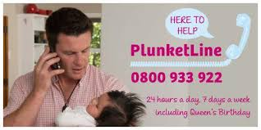
Notes:
Plunketline is another service we provide. All New Zealand families whether they are enrolled with Plunket or not have access to our free phone service for additional advice and support regarding a variety of topics such as breastfeeding, PND, challenging behaviour, sleep and illness prevention and identification. Caregivers can access this free using a mobile phone or landline, and there are no limitations to the number of calls they can make. This service runs 24hrs 7 days a week including all public holidays. Ultimately, the Plunket Nurses’ that run this service undergo specific training related to phone based triaging, and in my opinion posses some of the most robust communication skills within our organisation.

Slide 21
Notes:
When looking at health outcomes one of the areas were our Well Child Tamariki Ora service has had a major impact has been on reducing our high rate of Sudden Unexpected Death in Infancy. In the late 1980s to early 1990s our SUDI rate was around 250 babies per year. Over this time we implemented the back to sleep campaign that was extremely effective. Today our rates are still high as given our annual birth rate of 55,000 we still loose around 40 babies to SUDI. However, this is a dramatic improvement on the rates we were experiencing at the turn of the century. Today these losses are mainly felt amongst our Maori communities, with Maori babies being 3x more likely to die from SUDI. Some of this trend is linked to the fact that bed sharing is a common practice within Maori culture, and relates back to traditional norms where whanau slept communally in Marae on the floor. This known risk factor of bed sharing is compounded by the fact that antenatal smoking rates amongst Maori women is a staggering 53% compared to non-Maori at only 8%.

Slide 22
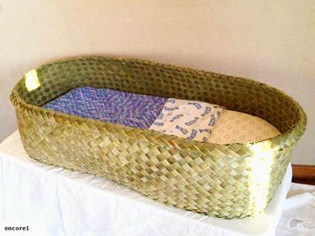
Notes:
Outside of providing ongoing smoking cessation support the distribution of pepi pods based on the design of traditional Wahakura is helping to further reduce our SUDI rates amongst Maori. Above is a traditional Wahakura that is made of flax. Flax Whahakura take considerable time and skill to make. Nationally there are workshops where expectant mothers can go and make their own Wahakura. This is very empowering as caregivers get the opportunity to engage in cultural practices that gives meaning to parenting through a Maori lens.

Slide 23
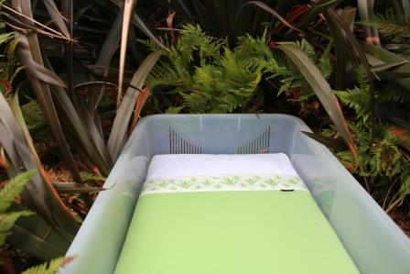
Notes:
However for those whanau who are unable to access these workshops Plunket along with other Well Child Tamariki Ora providers and some social services can gift whanau a pepi pod. The Whanau receives the container, mattress and bedding to keep, which includes a gorgeous merino blanket. The family can choose to keep the pepi pod for future babies or pass it on. The only condition is that the caregivers must undergo basic SUDI prevention training, and to pass these safe sleep messages on if they do choose to share the pepi pod. Woven within this training is cultural values around how infants and children were revered as tonga or treasures within traditional Maori society and how the Wahakura was consider the holder of something sacred. Reference to the importance of the first breath within Maori culture and how it relates to keeping baby smoke free is also endorsed, with principles relating back to positive parenting, bonding and attachment promoted. As described, all interactions within our well child tamariki ora program links back to the importance of supporting the infant or child to develop a positive sense of self through the development of secure meaningful relationships.

Slide 24

Storytime Foundation
Notes:
Plunket is also involved in cross sectorial funding models in order to enhance New Zealand’s ongoing understanding of the importance of the first 1000 days in a child’s life. In recent years these principles have prompted the Ministry of Social Development to invest in our program . This preventative step acknowledges the positive impact that Well Child Tamariki Ora Nursing can have on reducing our child abuse rates. Promoting strong secure attachments and supporting the development of resilient families who are well connected within their communities is seen as a vehicle for change to reducing the negative impacts that Adverse Childhood Experiences can have at both an individual and societal level. It is also anticipated that this will help to reduce our high rate of incarceration that is currently above the OECD average. As a Plunket nurse I am also able to tap into other services aimed at increasing bonding and attachment. For example, within the Waikato region we are one of the leading providers of the Storytime foundation service. The Story time foundation provides 5 books to children in their first years of life within predominantly high needs communities. With this service we are able to promote the importance of reading to improve literacy levels. We are also able to promote positive infant engagement between baby and caregiver through the use of tone, language, body language and touch. Caregivers are therefore exposed to the power reading to their child can have on the development of positive neural pathways during this crucial time in their babies brain development. In relation to our incarceration rates promoting reading is considered essential given that 90% of inmates in New Zealand have low literacy levels.

Slide 25


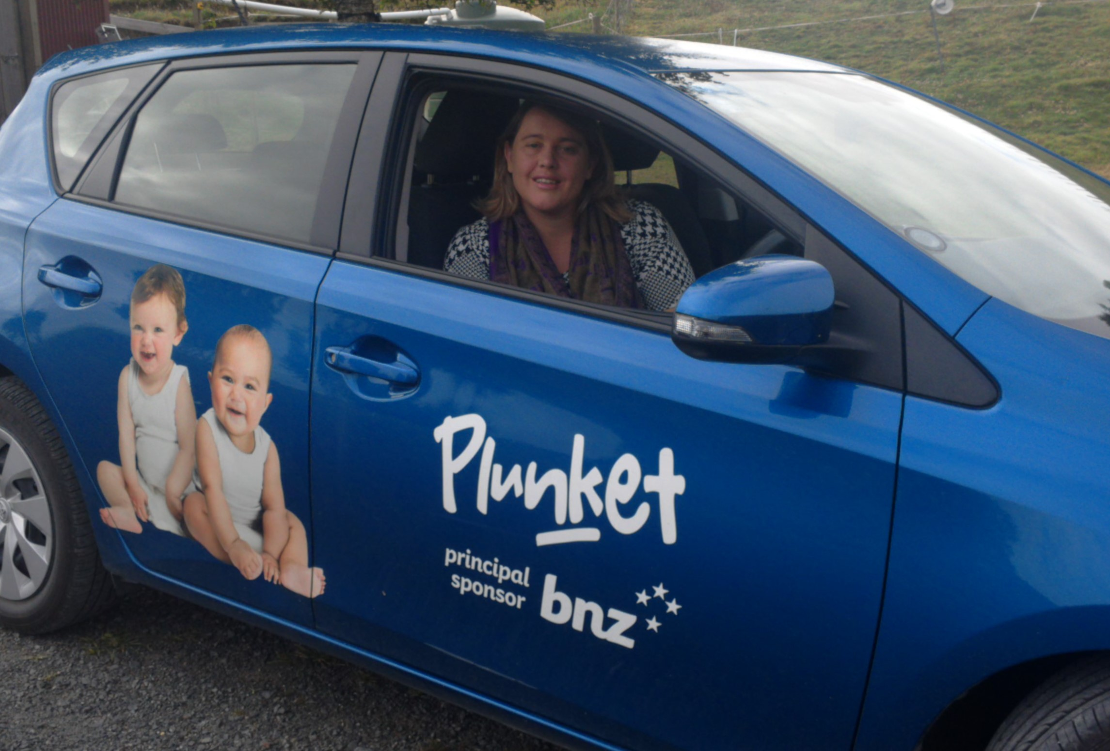


Sponsors

Slide 26
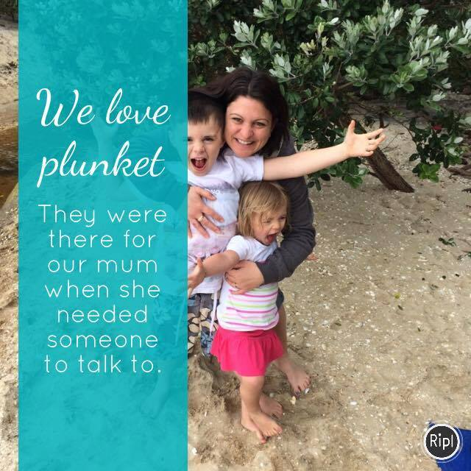
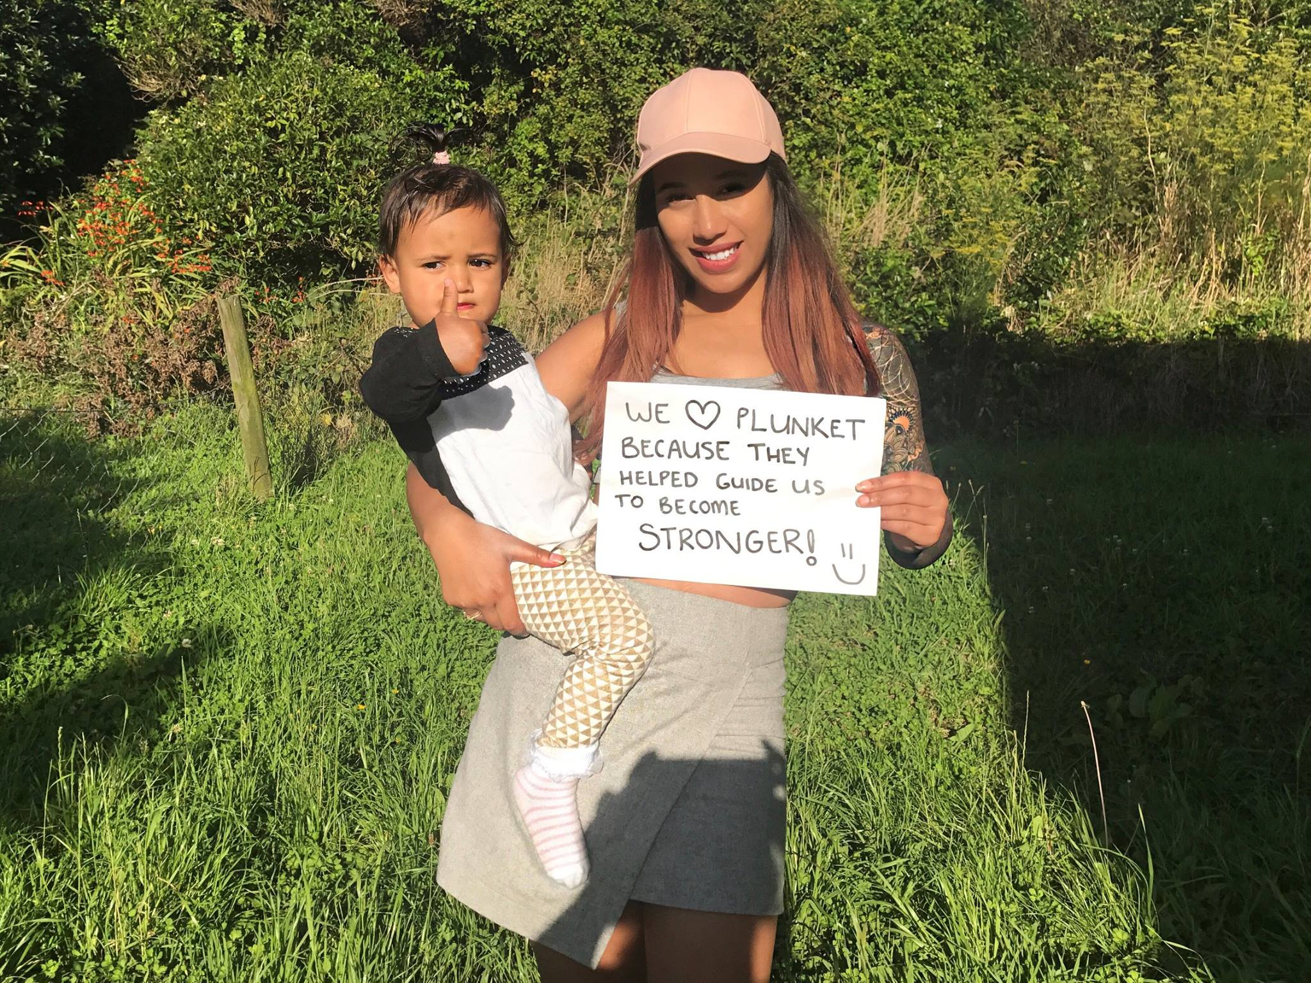
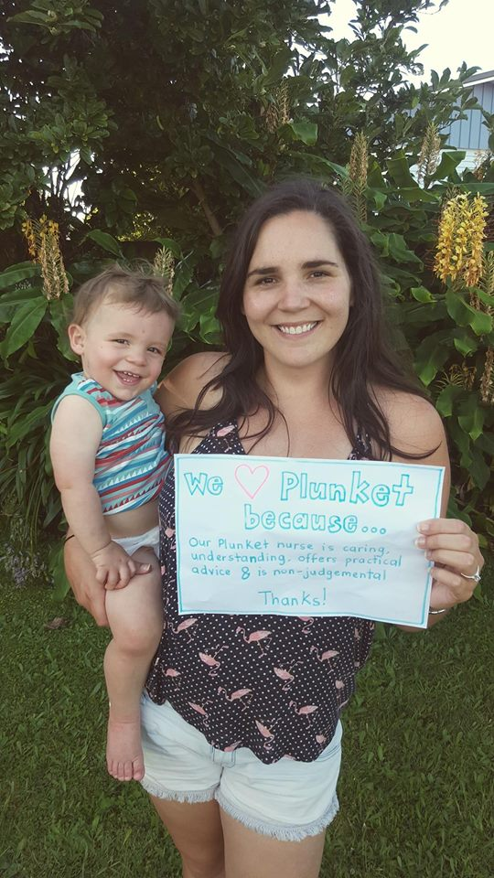
Future of Plunket
Notes:
Moving forward. At Plunket we recognise that we are over a 100 years old and that as an organisation we need to continue to grow and develop to remain relevant to families living in New Zealand now and in the future. We are already a well known brand to several generations of families who have been brought up as Plunket babies. However, like many countries we are becoming a multicultural society and risk becoming obsolete if we do not promote and value the amazing service we provide. In response to this we have recently converted from a paper health record to an electronic version. This system is not perfect but holds great potential. It now means that we can have immediate access to a clients health record anywhere in the country. We are also heading towards an interactive electronic client book that is compatible with smartphones. Being electronic has also meant that for the first time Plunket Staff have regular access to the internet. In an age of connectivity having instant access to the information families need whilst also helping them to navigate through the nightmare that is “DR GOOGLE” is essential. We are also keen to embrace all that social media has to offer in order to reach families and connect them to the services they need. Finding out what is relevant for Kiwi families has been supported by investing in steering groups made up of both clients and staff to find out what changes we need to make to remain relevant in the lives of the families we see today and in the future. This has generated a lot of amazing ideas, which we plan to implement over the next 5-10 years.

Slide 27
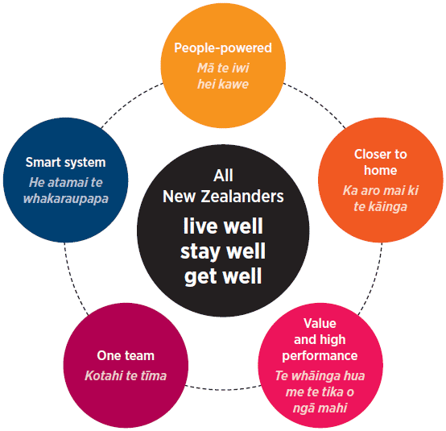
Nurse Prescribing Roles
Five Strategic Themes from the New Zealand Health Strategy
(MOH, 2016)
Notes:
One such initiative that we are looking at developing is nurse prescribing roles within our organisation. Currently in New Zealand we have the Nurse Practioner scope, which like most countries requires a masters of clinical nursing and endorsement through a nursing council. In New Zealand this involves the completion of a comprehensive portfolio and the passing of a panel review based on case scenarios. Nurse Practitioners in New Zealand are authorised prescribers. This means that they self regulate their scope including the therapeutic agents they prescribe by ensuring that it fits within their area of expertise. Therefore they have full access to the publically funded therapeutic agents available including controlled drugs. They are however subject to being audited at anytime to ensure that they are practicing safety. New Zealand has also recently introduced a nurse prescribing role. This scope requires a postgraduate diploma that incorporates pathophysiology, pharmacology, clinical assessment and a prescribing practicum. These roles require the supervision of a medical or nurse practitioner and is based on a defined formulary dependent on the nurse prescribers area of practise. Currently there are no nurse practitioners or nurse prescribers working within the field of Well Child Tamariki Ora Nursing. As previously mentioned the purpose of this trip has been to develop pathways to enable individual nurses to identify a need within their community were an expert level of care is needed, and to be able to develop a service to meet that need. In particular the development of these roles will help to up hold the themes of our current New Zealand Health Strategy which promotes developing close to home health initiatives that encourage individuals and families to live well, stay well and get well.

Slide 28
Nurse Prescribing Roles
Serious Skin Infections
Eczema Management
Upper and Lower Respiratory Tract Infections
Otitis Media Management
Urinary Tract Infections
Constipation
Contraception and Sexual Health
Anaemia
Hypertension
Notes:
For instance in Ngaruawahia where I work the local medical centre that provides the community with primary health care often struggles to meet the communities need. This is a reflection of the increased chronicity found within high needs communities, and our national GP shortage. Often I will visit a family and advise them that their child needs to be seen urgently by a doctor. However, they can’t get an appointment for 3-4 days. This requires the family to access A&E services in Hamilton. For many of my families who don’t have regular access to a car this can cause significant distress. This trend is reported nationally were 21.5% of caregivers of children aged 0-14 reported unmet need when accessing primary healthcare in regards to lack of transport or unavailable appointments. Of significance is that families living in high deprivation experienced a further 18% increase in unmet need than those living in low deprivation. In my community some of the key areas were having the capacity to prescribe could improve health outcomes through reducing barriers to primary healthcare are:
1) Serious skin infections and eczema management. Having the time to show caregivers how to apply topical steroids and moisturisers, and how to maintain an adequate skin barrier in their own home would in my opinion be extremely beneficial. Incorporated within this approach would be an opportunity to demonstrate infant massage, which once again promotes bonding and attachment. I also see a lot of head lice and scabies, so being able to provide families with on the spot treatment and showing them how to apply the lotions along with environmental factors such as linen hygiene would be amazing.
2) Otitis Media management and ongoing assessment to prevent or detect the development of Otitis Media with infusion would also be beneficial. In the community that I work I have a lot of children labelled as “Naughty” who actually have a significant hearing impairment that is impacting their ability to engage with their peers and family. Being able to provide preventative education along with early identification and management of this condition would help to reduce some of the behavioural issues I see frequently.
3) Supporting parents to manage and or treat upper and lower reparatory tract infections would also be a key area within this scope. Particularly in the Waikato where bronchiolitis is prevalent. For older children being able to assess and reassess asthma within their home environment in my mind provides an holistic approach to health management. This would include the full assessment of environmental factors, and linking eligible families up to social services such as our nation wide warm up the home project.
4) For mothers and some babies being able to assess and manage conditions such as anaemia, constipation, hyper and hypo thyrodisum, hypertension, hyperlipidaemia and other weight related issues would also be helpful
5) And being able to improve access to contraception and STI screening is a personal passion of mine. In my community it costs adults $17 dollars to access the local GP and a further $5 to fill the script. This may not sound like a lot, but for a family struggling to buy the basics it can seem like a want rather than a need. I personally would like to create a service were families could access contraception for a minimal fee, whilst also having immediate access to the medications they need. This would dramatically reduce the rate of unplanned pregnancy and potential STI that I currently see in the community that I work.

Slide 29

Notes:
Well that’s a little about me and what I do on a day to day basis. Once again I would like to thank you for coming and listening to my talk on the landscape that is Well Child Tamariki Ora Nursing in Aotearoa New Zealand, and I am happy to try and answer any questions you may have.

Slide 30
Reference List
Durie M. 1998. Whaiora: Māori Health Development. Auckland: Oxford University Press.
Davis, H., & Day, C. (2010). Working in partnership: the family partnership model. Pearson
Minister of Health. 2016. New Zealand Health Strategy: Future direction. Wellington: Ministry of Health.
Ministry of Health. 2014. Well Child / Tamariki Ora Programme Practitioner Handbook: Supporting families and whānau to promote their child’s health and development. Revised 2014. Wellington: Ministry of Health.
Mitchell, E. A., Blair, P. S. (2012). Sids prevention: 3000 saved but we can do better. The New Zealand Medical Journal. 10 August 2012, Vol 125 no 1359

